Slide 1

Lariat Rent-A-Car
Creating Balance for the Future

Slide 2
Lariat Rent-A-Car
Proposal 1
Insurance Reduction
Proposal 3
Rate Increase
Combined Proposal
Proposal 2
Fleet Reduction

Slide 3
Individual Car Overview Dashboard

Slide 4
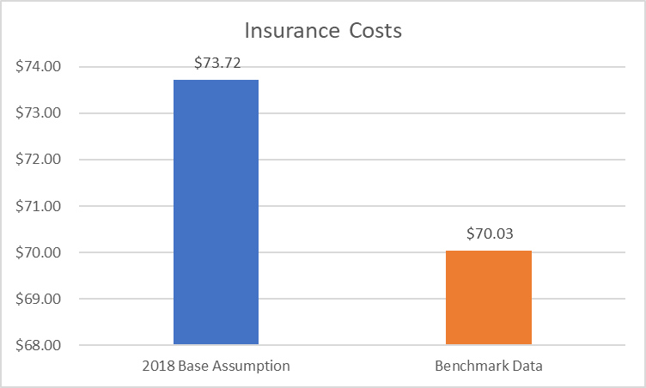
Insurance Reduction: Look to find insurance plans that would reduce monthly premiums.

Slide 5
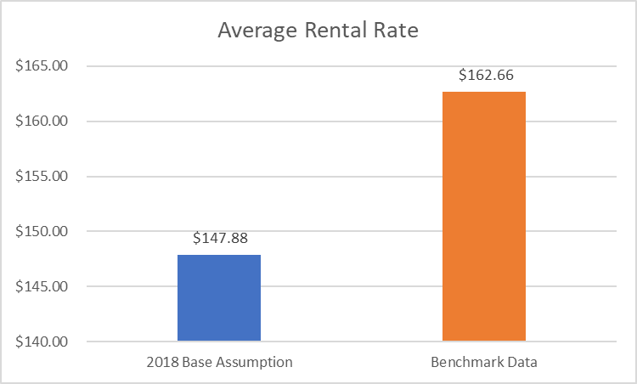
Rental Rate Increase: To cover maintenance costs and insurance for fleet.

Slide 6

Fleet Reduction: Decommission portion of the fleet that is costing more in maintenance and insurance for the company than revenue that is being brought in.
Even with an increase in rental rate and decrease in Insurance Premium!

Slide 7
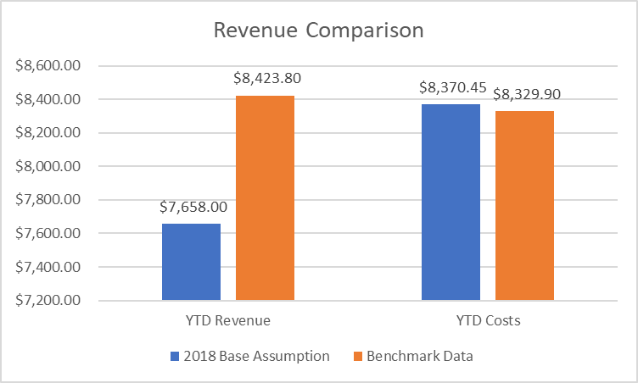
A Combined solution that will increase Total Gross and Net Revenue for the business.

